Slide 1
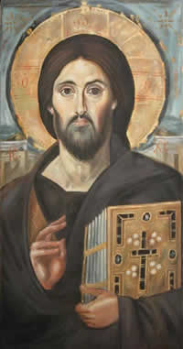
Jesus: Divine, Human and Sinless LORD
Finding out more about who Jesus is

Slide 2
THE ONLY FOUNDATION
Jesus Christ is the only sure foundation for everything.

Slide 3
JESUS’ DIVINE NATURE
λόγος something spoken, an idea, opinion or declaration, from…
λέγω I say, speak, I mean.
We know how God created the universe: through Jesus, His eternal Word.

Slide 4
SON OF GOD
When Jesus represents God the Father, he in no way takes anything away from God: Jesus accurately represents God in all His fulness.

Slide 5
JESUS’ SINLESSNESS
Jesus was the only person who ever qualified to redeem humanity from sin.

Slide 6
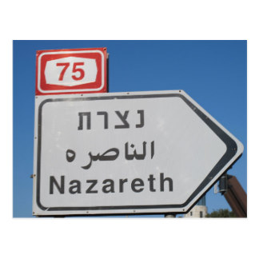
JESUS’ HUMANITY
Jesus was not just a human being but one from a specific people-group. Not just Jesus of Nazareth but Jesus of Nazareth, the Jew.

Slide 7
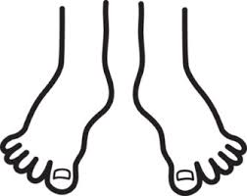
JESUS’ LORDSHIP
God has exalted Jesus to the highest place and at His Name every knee will bow.

